Slide 1
Continuing Education: Finite Element Methods
Overview of Technique
Sample Element Library
Errors Associated with the technique
1D Elements
Direct Stiffness Method
Energy
2D Elements
Energy

Slide 2
Finite Element Replaces the Actual Problem with a Simpler One.
Babylonians (1900-1680 B.C.E)
Calculation of radius of circle, π=3
Closer approximation found, π=3.125
Egyptian Papyrus
(1800 B.C.E.) Correct formula for volume of a pyramid and area of a sphere
(1500 B.C.E.) Egyptians using π= 10^{1/2} (3.16).
Archimedes of Syracuse (287-212 B.C.E)
Pythagoream theorem and two regular polygons
Inscribing and circumscribing, π= to
Chinese, (429-501)
Zu Chongzhi/Tsu Chung Chik: 24,576-gon, π=355/113
Notes:
Archimedes uses of finite element to calculate volumes of solids brought him to the threshold of calculus.
Chinese independently developed the use of polygons to inscribe and circumscribe circles and averaging the results to compute Pi

Slide 3
Finite Element Essential for Complex Structures.
Jet Powered Aircraft/Swept Winged Structures
Force Methods (S. Levy, 1947)
Based on elasticity theory: equilibrium of forces and continuity of displacements
Direct Stiffness Formulations (H.U. Schuerch,1953)
Stiffness Matrix Based on Assumed Displacements (Turner et al./Boeing, 1956)
FE Based on Principle of Minimum Potential Energy (1960’s)

Slide 4
Small But Finite Well-Defined Substructures
Elements
Nodes
Notes:
Continuous elastic structure
Continuum
Divided into small but finite well-defined substructures (elements)
Discretized
ELEMENTS → Material Properties, Geometry, Stress, Strain
NODES → Loads and Displacements

Slide 5
Errors Associated with Elements
Computational
round-off errors
numerical integration error
Discretization
geometric
displacement distributions

Slide 6
One Dimensional (Line) Elements
Pin-ended bar in
tension or
compression
Truss
2 Nodes
Beam
2 Nodes
Bending
Axial, torsional,
bending. With or
without load
Stiffening.
Frame
2 Nodes

Slide 7
Two Dimensional (Surface) Elements
4-node
quadrilateral
4 Nodes
Plane stress or strain,
axisymmetry, shear
panel, thin flat plate
in bending
8-node
quadrilateral
8 Nodes
Plane stress or strain,
thin plate in bending
Plane stress or strain,
axisymmetry, shear
panel, thin flat plate
in bending. Prefer quad where possible. Used for transitions of quads.
3-node
triangular
3 Nodes
6-node
triangular
6 Nodes
Plane stress or strain,
axisymmetry, thin flat plate
or shell in bending. Prefer quad where possible.

Slide 8
Three Dimensional (Solid) Elements
Hexagonal
(Brick)
8-nodes
Solid,
Thick plate
16-nodes
Pentagonal
(Wedge)
6-nodes
Solid,
Thick Plate,
Used for transitions
12-nodes
Tetrahedron
(Tet)
4-nodes
Solid,
Thick Plate,
Used for transitions
8-nodes

Slide 9
Sample Special Purpose Elements
Gap
Free displacement for
prescribed compressive gap
2-Nodes
Hook
2-Nodes
Free displacement for
prescribed extension gap
Rigid
Variable
Rigid constraints
between nodes

Slide 10
Energy Methods are Essential for Advanced Elements
Direct Stiffness Method
Easy to understand physically
More difficult to apply to complex element
Rayleigh-Ritz Method
Based on energy methods
Easier to implement on complex elements
More flexibility in simulating load and boundary conditions

Slide 11
One-Dimensional Truss Element: Direct Stiffness Development
y
f_{xi}
f_{xj}
u_{i}
u_{j}
x
i
j
x_{i}
L_{e}
x_{j}

Slide 12
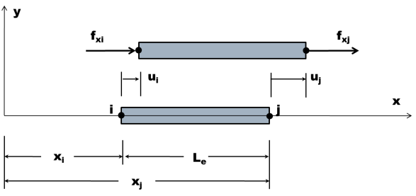
A Displacement Field is Assumed, u(x, nodal par).
Simplest Function for Displacement Field
One dimensional element
Two nodes
1
At the two nodal points u(x) can be written.
2
3
Notes:
The simplest function that can be assumed for the displacement function in terms of x and the nodal parameters.

Slide 13
The Displacement Functions are in Terms of u_{i} and u_{j}
2
3
1
Substituting and into
4
Shape Functions or
Interpolation Functions
Notes:
The simplest function that can be assumed for the displacement function in terms of x and the nodal parameters.

Slide 14
Shape Functions Critical To Element Development
4
1
N_{i}
0
x
i
j
1
N_{j}
0
x
i
j
Notes:
The simplest function that can be assumed for the displacement function in terms of x and the nodal parameters.

Slide 15
From Elasticity’s Strain-Displacement Relationship ε_{x}
Substituting in
4
5
[B] matrix
Notes:
The simplest function that can be assumed for the displacement function in terms of x and the nodal parameters.

Slide 16
From Elasticity’s Constitutive Relationship σ_{x}
Substituting in
5
6
Notes:
The simplest function that can be assumed for the displacement function in terms of x and the nodal parameters.

Slide 17
Stress Multiplied by Area gives Nodal Forces
The sign comes from the Convention that on a negative surface a tensile stress (and the force associated with it) will be directed in the negative coordinate direction
Substituting in
6
7
Notes:
The simplest function that can be assumed for the displacement function in terms of x and the nodal parameters.

Slide 18
The Stiffness Matrix Relates Forces and Displacements
7
[k]_{e} ≡ Stiffness Matrix
8
Notes:
The simplest function that can be assumed for the displacement function in terms of x and the nodal parameters.

Slide 19
A Summary of the Direct Stiffness Steps
Define
the displacements and loads associated with the degrees of freedom of the nodes
the geometry and material properties of the elements
Assume a deflection field of the element
as many unknowns as degrees of freedom
Determine the unknown constants in terms of nodal position and displacements
Differentiate the displacement field equations to obtain the strain as a function of nodal displacements
Substitute the stress-strain relations to write the stress as a function of nodal Displacement

Slide 20
Rayleigh-Ritz Based on Principle of Minimum Total Potential Energy
From Previous Lecture on Energy Methods
9
Variational Methods used to Extremize Π
Notes:
From the previous page, the right hand side is the variation of the Strain Energy U
The Total Potential Energy Principle satisfies Equilibrium, some Elastic Constitutive Laws, and Kinematic Compstibility

Slide 21
Total Potential Energy Needs to be Written in Terms of Displacements
Assume a Form for the Displacements Fields ( )
Must satisfy the geometric boundary conditions
1
2
3
Substituting in and
4
The Total Potential Energy is Written in Terms of the Nodal Displacements and then is Minimized
10
Notes:
From the previous page, the right hand side is the variation of the Strain Energy U
The Total Potential Energy Principle satisfies Equilibrium, some Elastic Constitutive Laws, and Kinematic Compstibility

Slide 22
The Strain Energy for the Beam is Easily Calculated
Strain Energy is given by
The Stress Matrix was previously found .
6
Notes:
From the previous page, the right hand side is the variation of the Strain Energy U
The Total Potential Energy Principle satisfies Equilibrium, some Elastic Constitutive Laws, and Kinematic Compstibility

Slide 23
A General Form of the Strain Energy for the Beam is Found
Previous Result for the Strain
5
The Expression for the Strain Energy (dv=A_{e}dx)
7
11
Notes:
From the previous page, the right hand side is the variation of the Strain Energy U
The Total Potential Energy Principle satisfies Equilibrium, some Elastic Constitutive Laws, and Kinematic Compstibility

Slide 24
The Total Potential Energy Can Now Be Calculated,
Starting with
9
The External Potential Energy V_{e} can be written
12
Substituting and into
11
10
9
13
Notes:
Work Potential is opposite in sign to the work performed on the system

Slide 25
Expanding the Total Potential Energy Expression
To help make the derivative of easier to follow, is expanded
13
14
Notes:
Work Potential is opposite in sign to the work performed on the system

Slide 26
Taking the Derivative of the Total Potential Energy Expression
14
First with Respect to u_{i}
15
Notes:
Work Potential is opposite in sign to the work performed on the system

Slide 27
Taking the Derivative of the Total Potential Energy Expression
14
First with Respect to u_{j}
16
Notes:
Work Potential is opposite in sign to the work performed on the system

Slide 28
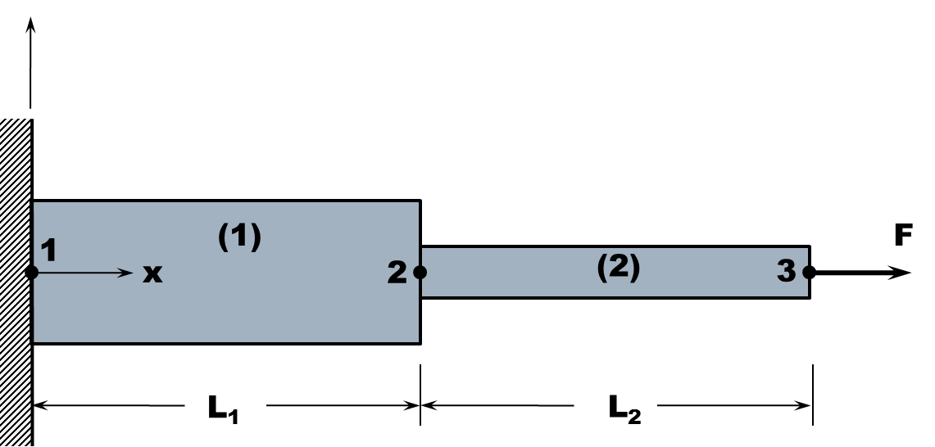
Writing and in Matrix Form
15
16
15
16
17
This is the same result as
7
Notes:
Work Potential is opposite in sign to the work performed on the system

Slide 29
A Two-Element Axial Structure Used to Demonstrate Assembly
y
A₁
A₂
1
(1)
F
x
2
(2)
3
L₁
L₂

Slide 30
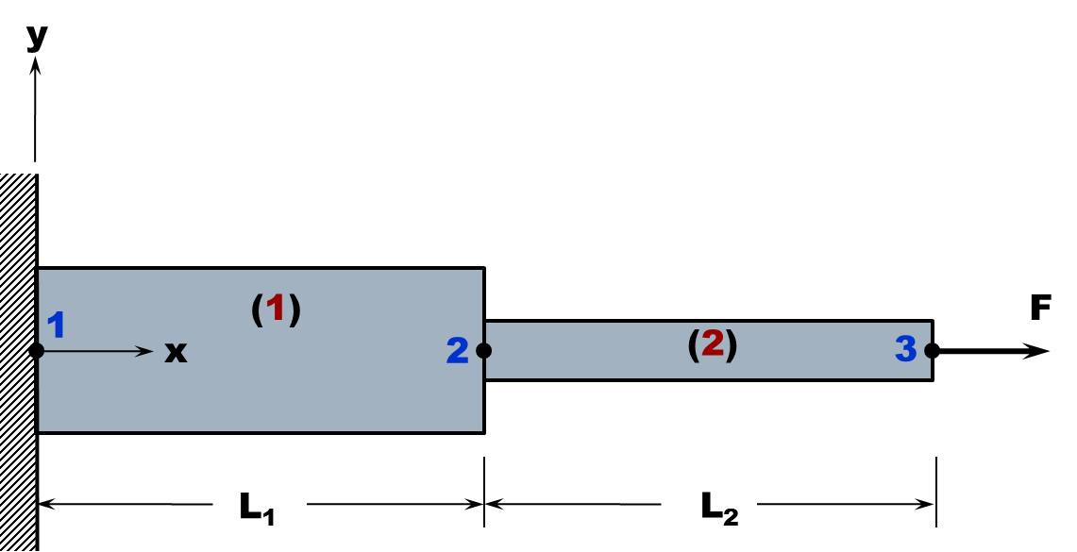
The Structure is Discretized.
F₁
F₂
F₃
1
(1)
2
(2)
3
L₁
L₂
1
(1)
2
2
(2)
3

Slide 31
Assembling the Stiffness Matrix for the Entire Structure
17
L₁
L₂
x
1
(1)
2
2
(2)
3
18
19
Notes:
Work Potential is opposite in sign to the work performed on the system

Slide 32
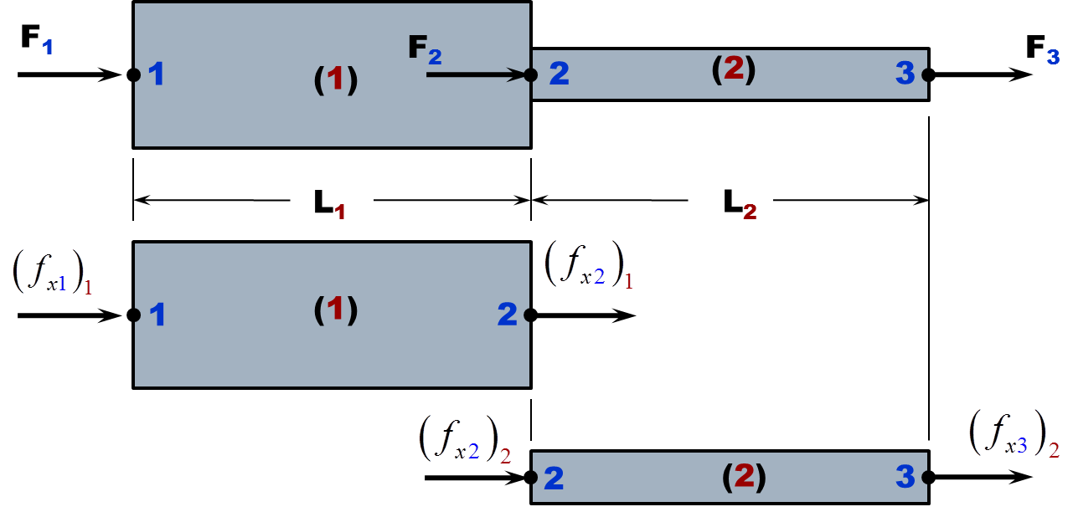
Totaling Forces at Leads to System Stiffness Matrix
18
19
20
Notes:
Nodal Force Vector
Stiffness Matrix
Displacement Vector
Note how 18 and 19 overlap in 20

Slide 33
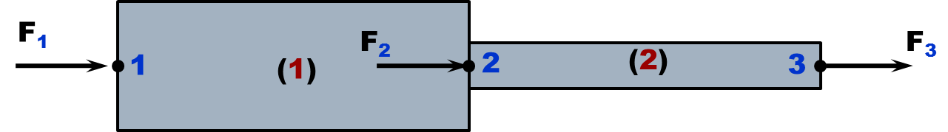
Totaling Forces at Leads to System Stiffness Matrix
20
Net Applied Forces at Nodes
Notes:
Nodal Force Vector
Stiffness Matrix
Displacement Vector
Note how 18 and 19 overlap in 20

Slide 34
Partition Out Force Equations Where Displacements Known
0
21
22
Notes:
Nodal Force Vector
Stiffness Matrix
Displacement Vector
Note how 18 and 19 overlap in 20

Slide 35
Reduced Stiffness Matrix Inverted to Solve for Unknowns
22
0
21
25
0
23
F
24
Notes:
Nodal Force Vector
Stiffness Matrix
Displacement Vector
Note how 18 and 19 overlap in 20

Slide 36
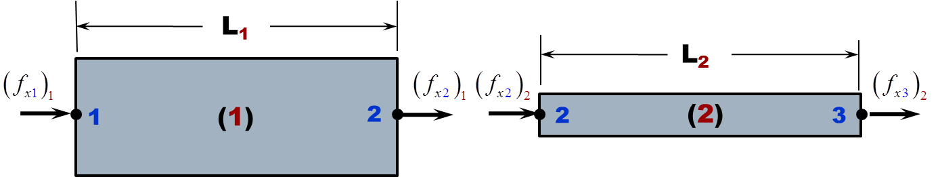
Nodal Forces Determined From Displacement Results
Starting with Element 1, using
18
18
From the BC u₁=0 and from u₂
23
26
Now for Element 2, using
19
19
From and
23
24
27
Notes:
Nodal Force Vector
Stiffness Matrix
Displacement Vector
Note how 18 and 19 overlap in 20

Slide 37
Stress Determined From Displacement Calculations
Starting with Element 1, using
6
From the BC u₁=0 and from u₂
23
Now for Element 2, using
6
From and
23
24
Notes:
Nodal Force Vector
Stiffness Matrix
Displacement Vector
Note how 18 and 19 overlap in 20

Slide 38
Energy Approach Simplifies Working With Distributed Loads
Starting with a system all 6 DOF
M_{yi}
M_{zi}
M_{yj}
M_{zj}
Body Forces per Unit Volume
M_{xi}
F_{xi}
i
j
F_{xj}
M_{xj}
F_{zi}
F_{yi}
F_{zj}
F_{yj}
Surface Force Distribution
Concentrated Forces
Concentrated Moments
The External Potential Energy for this System can be written
i and j correspond to a set of discrete loads
Notes:
Nodal Force Vector
Stiffness Matrix
Displacement Vector
Note how 18 and 19 overlap in 20

Slide 39
Energy Approach For 1D Axial Element With Distributed Loads
0
q₀ [force/length]
0
0
Notes:
The work equivalent nodal forces for the uniform load are both q_{o}L_{e}/2.
The work equivalent nodal forces are not always so obvious.

Slide 40
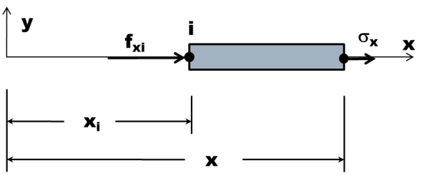
Equivalent Nodal Forces Added To Element Nodal Forces,
17
q₀ [force/length]
The Stress in the Element No Longer Constant
q₀
Notes:
The work equivalent nodal forces for the uniform load are both q_{o}L_{e}/2.
The work equivalent nodal forces are not always so obvious.

Slide 41

Example Problem
F=20kN
A₁=100mm²
A₂=75mm²
A₃=50mm²
E=50GPa
1. Using Closed form solution find the load in each section
2. Using the finite element method find the solution
3. Plot the stress and displacements for both.
y
(1)
(2)
(3)
1
x
F
2
3
4
200mm
150mm
125mm
1.0mm

Slide 42
Stressed Axial Element Undergoes Unconstrained ΔT
ΔT
The Total Strain, ε_{x}
28
From the stress becomes, σ_{x}
28
5
29
Notes:
The work equivalent nodal forces for the uniform load are both q_{o}L_{e}/2.

Slide 43
The Strain Energy, U, For The Element Is Computed Using &
28
29
ΔT
30
Notes:
The work equivalent nodal forces for the uniform load are both q_{o}L_{e}/2.

Slide 44
Rayleigh-Ritz Principle of Minimum Total Potential Energy on
ΔT
30
Thermal Nodal
Force Vector
Notes:
The work equivalent nodal forces for the uniform load are both q_{o}L_{e}/2.

Slide 45
2D Truss Element Requires Transformation Equations
y
u’_{j}
x’
φ_{y}
v_{j}
y_{j}
y’
j
u’_{i}
φ_{x}
u_{j}
v_{i}
y_{i}
i
u_{i}
x
x_{i}
x_{j}
Notes:
x,y – Global Coordinates
x’,y’ – Local Coordinates

Slide 46
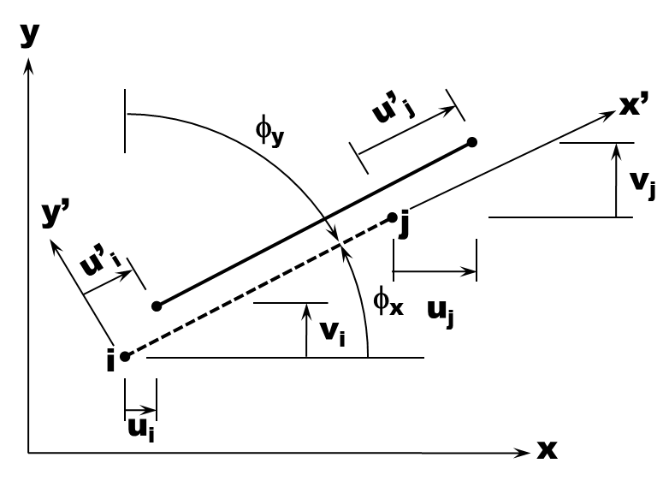
Displacement Transformed from Global to Local System
v⋅sinφ_{x}
=v⋅cosφ_{y}
u’
φ_{x}
u⋅cosφ_{x}
v
φ_{x}
u

Slide 47
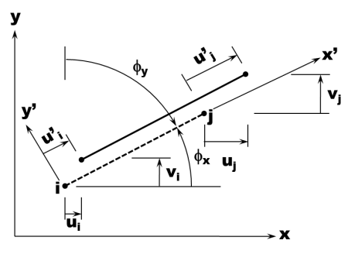
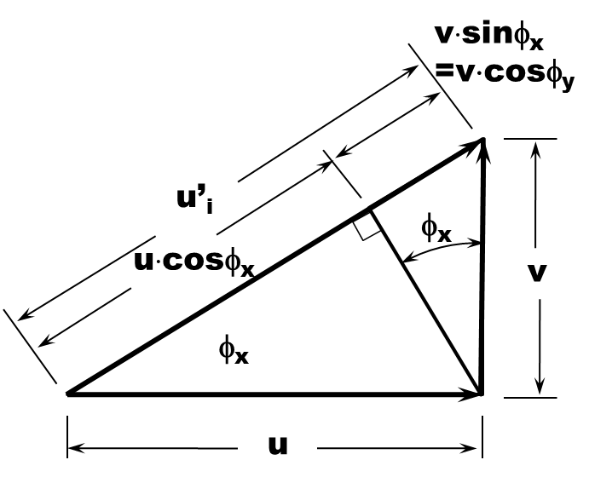
Transformations from Global to Local System in Matrix Form
Force Transforms using the same matrix
32
31

Slide 48
The Potential Energy In the Local and Global Systems
The Potential Energy in the Local System
7
The Potential Energy in Global Coordinates
33
Using
31
Minimizing Π_{e} in will give
34
33

Slide 49
The System Of Equations is Formed In Global Coordinates
34

Slide 50
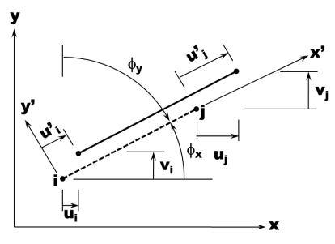
Forming The System Matrix More Complex Than 1D Case
34
35
Nodes do not follow each other in a serial manner
Two DOF at each node
Simplification to help organize the problem
For a given Element, always define
The lower element as the i node
The higher element as the j node
After the element equations are formulated with respect to the Element DOF, then expand with respect to the System DOF

Slide 51
Transformations for the 3D Truss Element
y
x’
θ_{y}
L_{e}
θ_{x}
y’
x
z’
θ_{z}
z
36

Slide 52
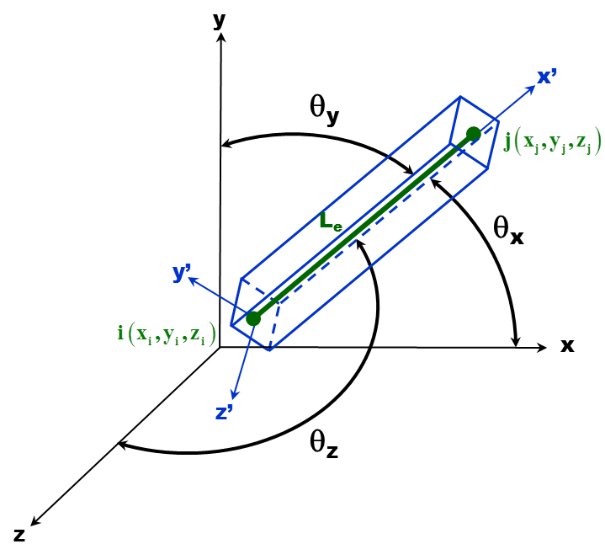
The Local Stiffness Matrix Can Now Be Transformed

Slide 53
Development of Beam and Frame Elements
A Displacement Field Must Be Assumed
Two nodes (i and j)
Each nodes had 2 DoF (v, θ)
E_{e}, I_{e}, A_{e}
y
L_{e}
V_{i}
i
j
x
V_{j}
M_{i}
M_{j}
Nodal Loads
Four unknowns in the Displacement Field
37
y
The slope can now be written
38
i
j
x
Nodal Displacements

Slide 54
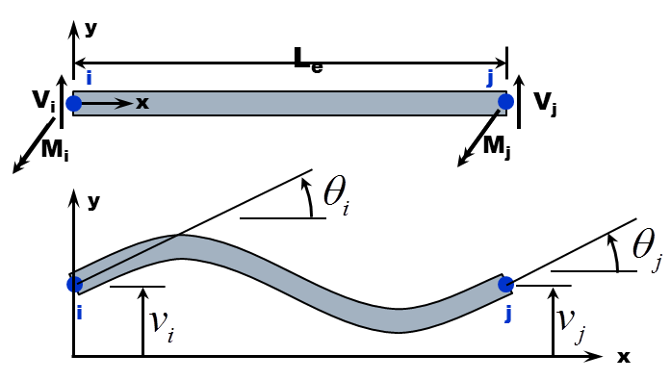
The Constants In And Are Found From BC’s
37
38
37
38
From the diagrams the Boundary Conditions are
Substituting these into and yield the following results for the constants
37
38
39
40
41
42

Slide 55
The Constants - Into Result In The Shape Functions
39
42
37
37
43
44
45
46
47

Slide 56
The Strain Energy As A Function of Nodal Displacements
43
The Strain Energy for a beam in bending is given by
48
From the second derivative can be determined
43
49

Slide 57
Taking The Second Derivatives Indicated
49
Given the values of the N’s in -
44
47
50
51
52
53

Slide 58
Writing The Strain Energy In Matrix Notation
48
The Strain Energy can now be computed
54

Slide 59
The Beam Element Stiffness Matrix Is Identified
56
54
From the previous development,
11
Substituting - and
integrating
50
53
55

Slide 60
The Total Potential Energy Is Computed
y
q(x)
P_{r}
s
x
r
M_{s}
For now only consider the concentrated load and moment

Slide 61
The Total Potential Energy Is Computed
y
P_{r}
s
x
r
M_{s}
For the Rayleigh-Ritz Method the derivatives of Π with respect to the displacements are taken

Slide 62
Taking The Derivatives Of The Total Potential Energy Gives [k]_{e}
y
P_{r}
s
x
r
M_{s}
56

Slide 63
Considering The Work Potential For the Distributed Load
y
q₀
V_{i}
x
V_{j}
M_{i}
i
M_{j}
j
Substituting into the above equation
L_{e}
43
57

Slide 64
Comparing Two Approaches To Distributed Load Distribution
Static and Work equivalent or consistent loads
y
x
i
j
y
q₀
x
i
j
L_{e}
y
Static equivalent loads
x
i
j

Slide 65
2D Elastic Elements: Constant Strain Triangle Element
Attributes of the Constant Strain
Triangle Element
Thin in the z-direction, t
Three nodes, ordered counter clockwise
Each node had 2 DoF
Element has 6 DoF
y
y_{k}
y_{j}
k
j
y_{i}
i
Need a total of 6 constants in the displacement field, u and v
x
x_{k}
x_{i}
x_{j}
58

Slide 66
Constants Determined By Substituting In Nodal Disp. In
58
y
58
y_{k}
y_{j}
k
j
y_{i}
i
x
59
x_{k}
x_{i}
x_{j}

Slide 67
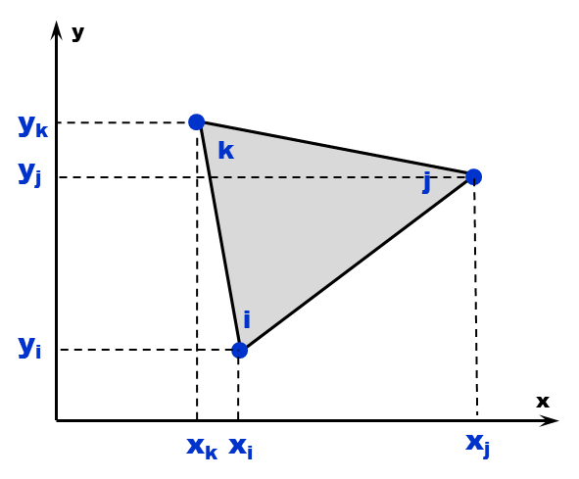
The Six Equations In Are Solved Simultaneously
59

Slide 68
The Previously Solved Constants and Are Combined
58
58
Substituting in the previously solved for constants
Rewriting in terms of Shape Functions
60
61

Slide 69
Strain Displacement Relationships And Used to Calculate Strains
61
From Strain-Displacement Relationships
61
62
63

Slide 70
Strain Can Now Be Written in Matrix Form
64
65

Slide 71
Plane Stress Relationships For Isotropic, Homogeneous Material
64
66
65

Slide 72
Plane Strain Relationships For Isotropic, Homogeneous Material
64
66
67

Slide 73
The Strain Energy Can Now Be Evaluated For Both Stress States
Substituting in the Transpose of
68
constant
Due to Symmetry of [D]
[k]_{e}

Slide 74
2D Isoparametric Quadrilatreral Element
η
y
(x_{l},y_{l})
l
(-1,1)
(1,1)
(x_{k},y_{k})
Natural
Coordinates
k
l
k
Map
ξ
i
(x_{i},y_{i})
i
j
j
(x_{j},y_{j})
x
(-1,-1)
(1,-1_{j})

Slide 75
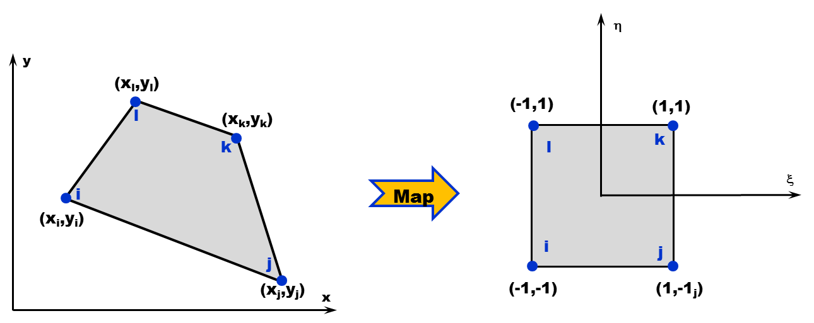
4 Nodes, 2 DoF Results In 8 Constants

Slide 76
Shape Functions Critical To Element Development
4
1
N_{i}
0
x
i
j
1
N_{j}
0
x
i
j
Notes:
The simplest function that can be assumed for the displacement function in terms of x and the nodal parameters.

Slide 77
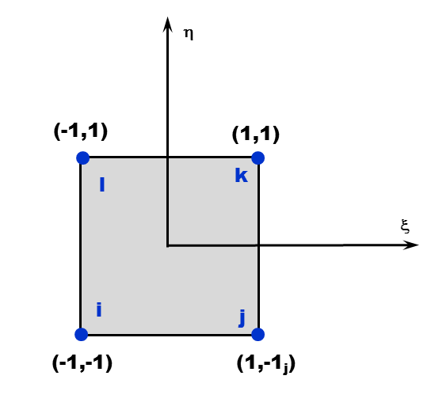
Determining Shape Functions
For Shape Function N_{i}
N_{i}=1 at node I, when ξ=-1 and η=-1
N_{i}=0 at all other nodes, when ξ=η=1
In a similar manner
Deflections become

Slide 78
Calculation of Strains Give Rise To The Jacobian Matrix
For Derivatives in Strain-Displacement

Slide 79
Strains Are A Function Of x and y, Must Invert Jacobian

Slide 80
Strains Are A Function Of x and y, Must Invert

Slide 81
Derivatives Of u and v In Terms Of ξ and η

